Slide 1

Prison Management System
Data structures and Algorithms

Slide 2
Team members
Ahmad Waleed Akhtar BSCE22003
Muhammad Arham BSCE22007
Muhammad Miqdad Ahmad BSCE22001

Slide 3

INTRODUCTION
A project called "Police Management System" intends to make managing prison records easier. This system will offer a user-friendly interface for Admin, prisoner, and normal users while effectively storing and retrieving prison records using a binary tree data structure. Admin will have more authority over the system than a normal user. The system will also take complaints from all type of users and store them in a database.

Slide 4

Objectives
Creating a user-friendly interface
Efficiently managing data through binary trees.
Efficiently updating, adding and removing data.
Efficiently allowing users to see their relative's prison records.
Using QR codes for prisoner's identity and easy login for Admins.
Let prisoner only see his record.
Using a graphical user interface for Admin and the user.

Slide 5

Login system
Login access will only be given to Admin. Login will require the admin to enter the password and username known only by him.

Slide 6

Add update and remove
After successfully logging in Admin will be able to add new records, update existing records, and delete any record. He will also have the authority to check the details of any prisoner. He could see the solders on duty. And even the remaining time of any prisoner.

Slide 7
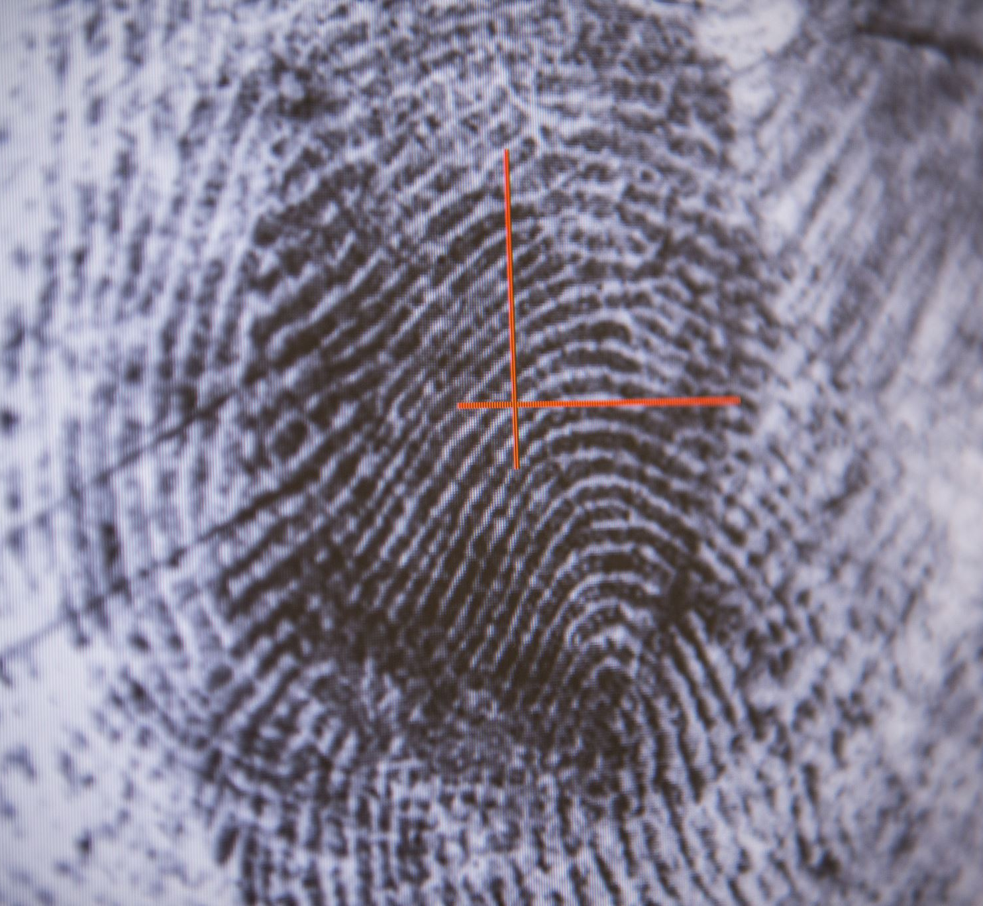
QR codes
Each prisoner and guard will have a unique ID. The id will be stored in a QR code. The system will be able to scan this ID and identify the person. Using this the prisoners will be able to check in and check out. Same is the case with the with the solders.

Slide 8

Ordinary users
Ordinary users will be able to see a prisoner’s record if they are related to him. They will also be able to request a time slot in which they can meet the prisoner.

Slide 9

Prisoner check in/check out
Prisoner will be able to check in when starting his daily job. Once he’s done, he will be able to check out. His working time will be noted. Depending upon the time he’s spent working he will be given food.

Slide 10

Prisoner checking
If a guard thinks that a prisoner is slacking off he can negate the time spent by the prisoner. But if done too many time, the admin will be notified.

Slide 11

Conclusion
A binary tree data structure will be used in the "Police Management System" project to provide an effective method of managing prison records. This system offers a structured, user-friendly, and secure platform for Prison operations, which will be advantageous to all admin, prisons and users.

Slide 12
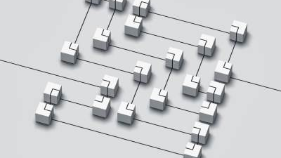
Data Flow diagram

Slide 13
